Slide 1
2.6 My Sensor
On this topic, need to explore more. Will be error on (@+dimen/acvitivit++++++)

Slide 2
activityMain.java (part1)
package com.example.mysensor; import android.hardware.Sensor; import android.hardware.SensorManager; import android.os.Bundle; import com.google.android.material.floatingactionbutton.FloatingActionButton; import com.google.android.material.snackbar.Snackbar; import androidx.appcompat.app.AppCompatActivity; import androidx.appcompat.widget.Toolbar; import android.view.View; import android.view.Menu; import android.view.MenuItem; import android.widget.TextView; import java.util.List;

Slide 3
activityMain.java (part2)
public class MainActivity extends AppCompatActivity { TextView tv1= null; private SensorManager mSensorManager; @Override protected void onCreate(Bundle savedInstanceState) { super.onCreate(savedInstanceState); setContentView(R.layout.activity_main); tv1 = (TextView) findViewById(R.id.textView2); tv1.setVisibility(View.GONE); mSensorManager = (SensorManager) getSystemService(SENSOR_SERVICE); List<Sensor> mList = mSensorManager.getSensorList(Sensor.TYPE_ALL); for(int i=1; i < mList.size();i++){ tv1.setVisibility(View.VISIBLE); tv1.append("\n" + mList.get(i).getName()+"\n" + mList.get(i).getVendor() +"\n" + mList.get(i).getVersion()); } Toolbar toolbar = findViewById(R.id.toolbar); setSupportActionBar(toolbar);

Slide 4
activityMain.java (part3)
FloatingActionButton fab = findViewById(R.id.fab); fab.setOnClickListener(new View.OnClickListener() { @Override public void onClick(View view) { Snackbar.make(view, "Replace with your own action", Snackbar.LENGTH_LONG) .setAction("Action", null).show(); } }); } @Override public boolean onCreateOptionsMenu(Menu menu) { // Inflate the menu; this adds items to the action bar if it is present. getMenuInflater().inflate(R.menu.menu_main, menu); return true; } @Override public boolean onOptionsItemSelected(MenuItem item) { // Handle action bar item clicks here. The action bar will // automatically handle clicks on the Home/Up button, so long // as you specify a parent activity in AndroidManifest.xml. int id = item.getItemId();

Slide 5
activityMain.java (part4)
//noinspection SimplifiableIfStatement if (id == R.id.action_settings) { return true; } return super.onOptionsItemSelected(item); } }

Slide 6
Context_main.xml (part1)
<?xml version="1.0" encoding="utf-8"?> <RelativeLayout xmlns:android="http://schemas.android.com/apk/res/android" xmlns:app="http://schemas.android.com/apk/res-auto" xmlns:tools="http://schemas.android.com/tools" android:layout_width="match_parent" android:layout_height="match_parent" android:paddingLeft="@dimen/activity_horizontal_margin" android:paddingTop="@dimen/activity_vertical_margin" android:paddingBottom="@dimen/activity_vertical_margin" app:layout_behavior="@string/appbar_scrolling_view_behavior" tools:context=".MainActivity" tools:showIn="@layout/activity_main" android:transitionGroup="true"> <TextView android:text="Sensor" android:layout_width="wrap_content" android:layout_height="wrap_content" android:id="@+id/textview" android:textSize="35dp" android:layout_alignParentTop="true" android:layout_centerHorizontal="true" />

Slide 7
Context_main.xml (part2)
<TextView android:layout_width="wrap_content" android:layout_height="wrap_content" android:text="New Text" android:id="@+id/textView2" android:layout_below="@+id/imageView" android:layout_alignParentBottom="true" android:layout_alignParentRight="true" android:layout_alignParentEnd="true" android:layout_alignParentLeft="true" android:layout_alignParentStart="true"/> </RelativeLayout>

Slide 8
If have error on context_main.xml at
android:paddingLeft="@dimen/activity_horizontal_margin" android:paddingTop="@dimen/activity_vertical_margin" android:paddingBottom="@dimen/activity_vertical_margin"
click on res then right click on values then click on *New* then click on *value resource file* and name it dimens then click finish. After which you paste the below code <?xml version="1.0" encoding="utf-8"?> <resources> <dimen name="activity_horizontal_margin">5dp</dimen> <dimen name="activity_vertical_margin">5dp</dimen> </resources>

Slide 9
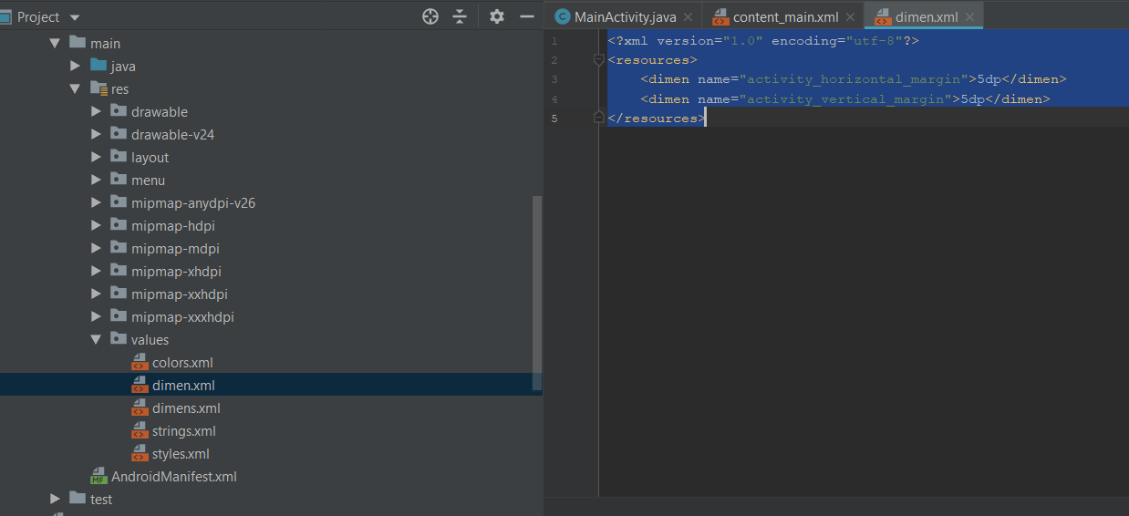

Slide 10
